Slide 1


How accurately can we predict the price of a car based on its features?
By Luke Hales

Slide 2


Why should anyone care?
In the modern day, cars are a necessity to be able to travel anywhere. This is especially true in the US, as the country is designed around driving by car with very few options to travel long distance by public transport [1].
Machine learning is becoming an ever more present part of everyday life. Almost every aspect of our lives is shaped by data, and the use of machine learning is to attempt to give accurate predictions based on the data it is provided [2].
Finding out what factors keep the price of a used car cheap would be very helpful for the average American, more so when considering the financial state the average US citizen finds themselves in.

Slide 3

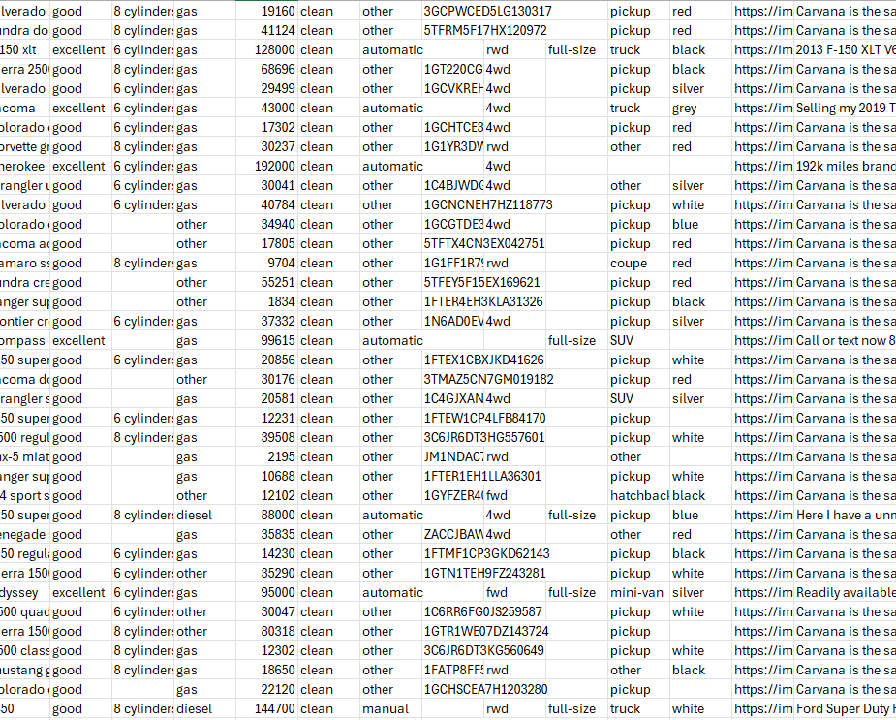
The Dataset
The dataset used is taken from Kaggle (https://www.kaggle.com/datasets/austinreese/craigslist-carstrucks-data)
This data is collected from Craigslist and includes all used car data entries in the United States, boasting 426880 unique entries.
The columns of this dataset include Region, Region_URL, Price, Year, Manufacturer, Model, Condition, Cylinders, Fuel, Odometer, Title_Status, Transmission, VIN, Drive, Size, Type, Paint_Color, Image_URL Description, County, State, Lat, Long, Posting_Date

Slide 4

The Dataset
Obviously, not all these columns are relevant factors to the price of the car. Columns such as URL do not have any effect on the price of the car.
The data needs to be cleaned before it can become usable, as there are many issues with the set such as outliers and missing data in columns of some entries.
Preprocessing is a delicate operation, as completing this task inadequately may result in bias in the model. The introduction of bias would then make the model worthless since it would not be able to accurately understand what factors affect the price the most.

Slide 5
Preprocessing
A correlation matrix is created to understand the initial relationships between the price and the other columns. The categorical columns are encoding using label encoding as this is a very simple technique that allows for categorical columns to be convert into numerical ones, making it possible to use in machine learning models.
The first step of preprocessing is to remove any columns that are not a feature of the car nor an aspect that may affect the price of a car. This includes “id”, “url”, “region_url”, “VIN”, “image_url”, “description”, and “posting_date”.
To factor in the location of the car, the “state” the car is being sold in is taken into consideration, with “region”, “lat” and “long” being dropped. The “county” column is also dropped as this only contains null values. The “state” column will be further processed later.

Slide 6
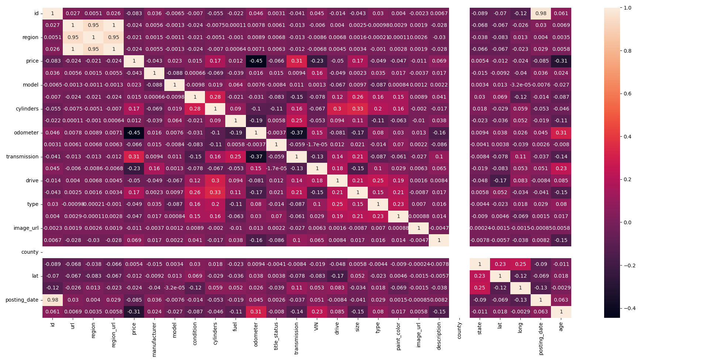

Slide 7
Preprocessing
Entries with outliers in the "odometer" and "price" columns are removed to stop the model learning from incorrect data. The Interquartile Range Method is applied to both columns. The minimum price a car can be is also set to 500 to prevent any further erroneous data.
The “year” column is replaced by a new column called “age”. While “year” is a numerical column, it acts more as a categorical one. Converting it in this way makes it easier for the numerical algorithm of the model to understand.
Another correlation matrix is created, with all columns that have a minimal effect on the price being dropped.

Slide 8
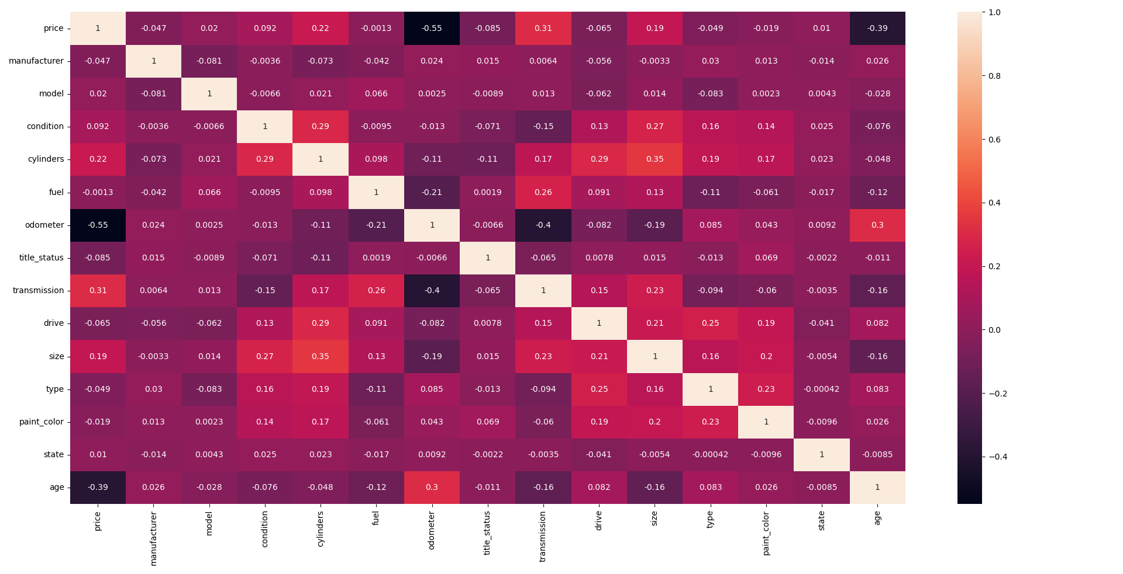

Slide 9
Preprocessing
From the correlation matrix, “price”, “age” , and “odometer” are the most important factors in this dataset. Therefore, all entries that do not have these columns present are dropped.
For all other columns, any NaN values are replaced with “unknown” to reduce bias as there are still important factors in these entries that the model needs to understand the relationships.
The categorical columns are encoded using On Hot Encoding. The advantage that One Hot Encoding has over Label Encoding is that it is much clearer for the model to understand. Label Encoding gives each category its own number, however, this may lead the model to assume that a larger number is somehow greater.

Slide 10
Preprocessing
To better correlate the car prices with states, K-means clustering is used. By finding the average price per state, each state is fit into a cluster based on how expensive or not the car is. There are 3 clusters they may be assigned to, high price, medium price, or low price. The number of clusters has been decided using the elbow method. This involves measuring the sum of squared distance of each data point to its closest cluster centre, with a lower score indicating better clustering. By plotting this value, called inertia, on a graph we can visualise the number of clusters in which the inertia value begins to plateau. The k value of this point is the value to use, in this case it is 3. Each entry is then assigned the correct cluster based on its state, with the state column being dropped after.
Before splitting the data into test and training sets, the price column is transformed into the log value of itself, eliminating the chance of the model producing any negative values.
The data is split into a training set and a testing set with an 80/20 split and is ready.

Slide 11
Regression Modelling
The most logical machine learning technique to use to make predictions is regression. We are predicting one dependent variable based on the relationship between many independent variables, which is what regression is designed to achieve.
Clustering was considered as an option for this dataset, however, this does not give a specific prediction of the price. This gives price ranges instead and a car would be placed into one of these bands based on the features provided. Placing a car in a price range would be more accurate as the model does not have to get the price correct to put it in the correct band. This, however, may not be specific enough which is why a regression model would be more suitable.
There are many different types of regression models that can be applied to this dataset.

Slide 12
Multiple Linear Regression
This method is the most basic in terms of attempting to find relationships between many independent variables and a dependent variable.
It is a supervised learning technique that assigns coefficients to each independent variable to map out the relationship between all the variables.
This methodology is the simplest to implement and will only receive a good R² score if the relationships between the columns are not complex.

Slide 13
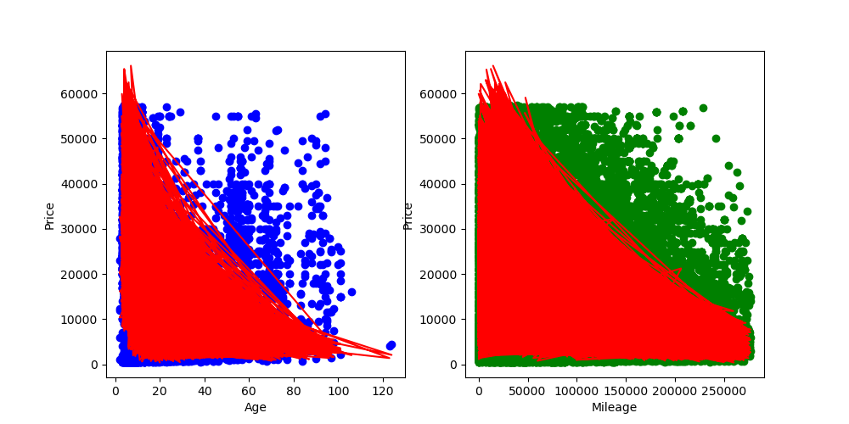
Multiple Linear Regression - Results
This model produces a score of ≈0.56 on the test data split. This is a poor scoring as it does not explain the relationship between all the variables well.
The general understanding of the data is captured by the model as shown by the price increasing as the age is younger and the mileage is lower, although the regression lines shown here are very sporadic. It is worth noting that part of this sporadic nature can be explained as we are only comparing this regression line against one variable at a time rather than taking into consideration all other independent variables. Another reason may be the fact that the y values in the test data are log transformations, and the graph is the exponentials of this.
While an attempt is made to remove outliers, there still may be prices in the data that do not seemingly correlate with the overall trend, and linear regression is poor at handling this.
This model would not be able to accurately predict the price of a car, which means that it would not be viable.

Slide 14
Multiple Ridge & LASSO Regression
To regularise the data and stop overfitting from being a potential factor that led to the linear regression model having a low R² score, Ridge and LASSO regression are also tested. The theory being that the Linear Regression model overfits the main cluster of data points and does not account for the data points that do not fully follow this.
This involves penalising the coefficients of the model, either proportionally to squared coefficients in Ridge or to absolute coefficients in LASSO.
By using cross-validation, it was discovered that the best alpha value for Ridge regression was 10 and for LASSO regression was 0.00001. Increasing the alpha value in LASSO in particular led to a really low model score of >0.3.

Slide 15
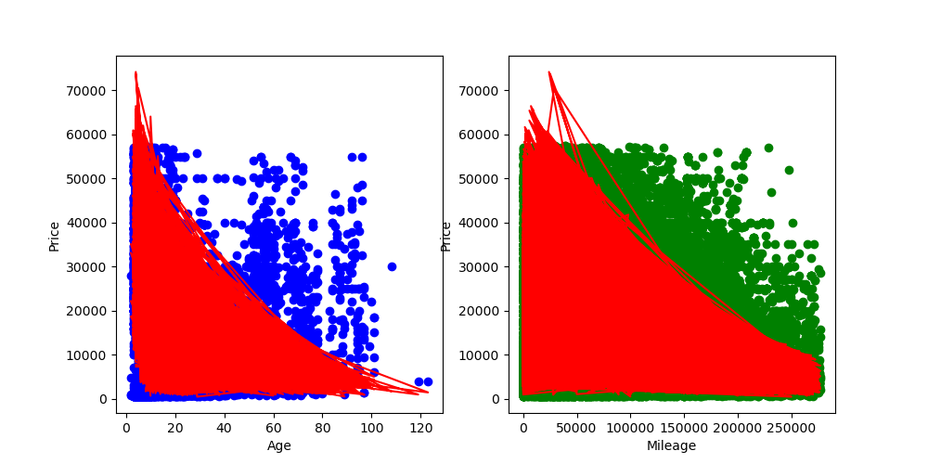

Multiple Ridge & LASSO Regression - Results
The scores for both models are ≈0.56 which unfortunately shows the initial theory about regularising the dataset has been disproven.
The same issue apply as with the previous model, showing that the complex relationships cannot be handled by any variant of linear regression and a more robust methodology must be selected to achieve this understanding.
Although it is a good idea to test the respective models with a wide variety of alpha values, the outcome of this for this particular dataset is undesirable. Even the most extreme alpha values tested could not change the model significantly. In some cases, this made the model worse by severely overfitting the regression line and causing high variance, which is the opposite effect we wish to achieve.

Slide 16
Random Forest Regression
To capture the complex relationships between all features, a random forest regressor can be used.
This involves creating a decision tree and based on the variable outcomes, following the splits until a leaf node is reached.
The trade-off for the model understanding the relationships is that there is more set up required. A grid search is used to fine tune the hyperparameters of the model. This is a structured method in which different hyperparameter values are tested to determine the best score for a model. These are cross-validated to ensure overfitting is not an issue.
The parameters chosen from this search are max_depth=20, max_features=None, max_leaf_nodes=9, n_estimators=150.

Slide 17
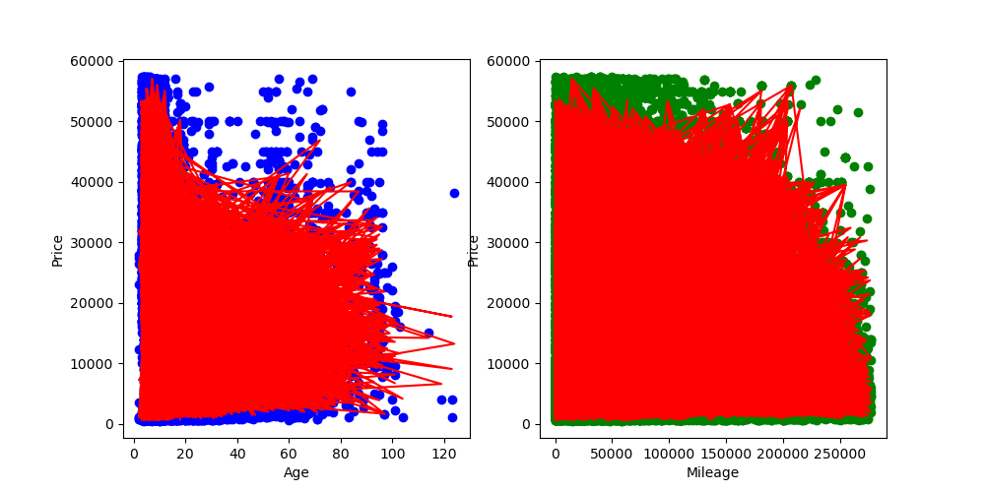
Random Forest Regression - Results
The model produced a score of ≈0.79. This model is significantly better than ones previously proposed as, unlike previous models, it does not bottleneck at a low score.
The regression line is clearly showing a better understanding of relationships as it takes it account a wider range of points on each graph, rather than focusing on the areas where the most points lie. We know this as the regression line lacks the curve the other models possess while still having a clear grasp on the trend.
The model should not suffer from overfitting as the hyperparameters used have been cross-validated as previously mentioned, making this an accurate model to predict car prices.
This model is also good at handling outliers unlike the previously proposed models

Slide 18
Conclusion
The project has shown that it is possible to predict the price of a car based on its features fairly accurately using random forest regression. While there is some variance in how far away the true price is from the predicted price, the difference is never too great and will normally fall close. Another way this is by using a Multi-layer perceptron regressor, a neural network designed for regression. Testing this form of model is more logical than using regularisation on review.
The preprocessing of the data was, overall, positive in how NaN values were handled and how specific columns were dropped. Not dropping all entries with NaN values present was beneficial as this aided the model in understanding how the more prevalent features affected the price.
Using the regions instead of the states when clustering locations together may have proven to be more accurate as the locations would not be so general. US states are massive meaning that a car that is expensive in one region may be cheaper in another region of the same state. This may have led to more clustering, but a better, more precise model.

Slide 19
Conclusion
The dataset itself was sufficient in the number of entries it possessed as well as the number of features about the car. This allowed for not only a lot of data to be input into the models to train them but also a lot of data to test the model’s accuracy – meaning that the models’ scores are reliable.
There may be unexplained reasons and features not present as to why a specific price is set, however. An example of this could be desperation to sell the car, as they may undervalue the car to get it sold.
The dataset may not be fully representative of the US car market because the data is taken from Craigslist only. This means that the models produced are only reflective of this small sample size rather than the entire market. This could lead to some cars not listed on Craigslist being inputted into the model and the price outputted is far-off from the true value.

Slide 20
Bibliography
[1] Ladd, B., 2011. Cities on wheels: Cars and public space. The New Blackwell Companion to the City, pp.265-274.
[2] Surden, H., 2021. Machine learning and law: An overview. Research Handbook on Big Data Law, pp.171-184.

